Slide 1
DTMF BASED HOME AUTOMATION
Group:4

Slide 2
Group -4 Members
NAME | ENROLLMENT NUMBER
Jinil Chandarana | AU1940121
Umang Patel | AU1940174
Maulikkumar Bhalani | AU1940206
Keyur Nagar | AU1940207

Slide 3
Objective
DTMF (Dual tone multi-frequency) is used to transfer data/message through signals using DTMF encoder and decoder.
The main objective of this project is to automate home appliances through remote control using DTMF.
The system provides flexibility to save electricity consumption and save time. Moreover, we can operate it from anywhere in the world.
This project lets you operate your home appliances such as lights, AC, fan, etc. using such signals from remote places with just a single switch.
Imagine how helpful it will be to be able to switch on your air conditioning system ten minutes before you return home on a hot summer !

Slide 4
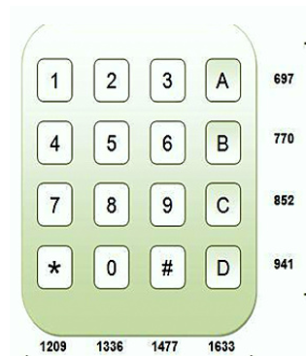
User interface-Input
On-screen mobile dial pad, a 4x4 key matrix, is the provided interface for the user.
The Rows are assigned 4 different low frequencies and the 4 high frequencies are assigned to the columns.
The assigned frequencies are neither multiple of the others nor the addition or subtraction, that being the case, pressing of each key generates a unique frequency.
Low frequencies : 697 Hz, 770 Hz, 852 Hz, 941 Hz.
High frequencies : 1209 Hz, 1336 Hz, 1477 Hz. 1633 Hz.

Slide 5
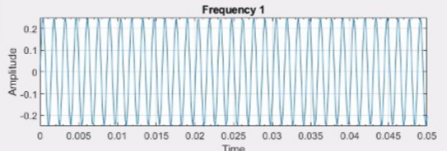
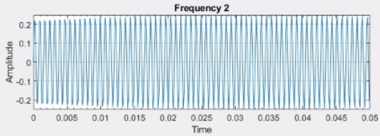
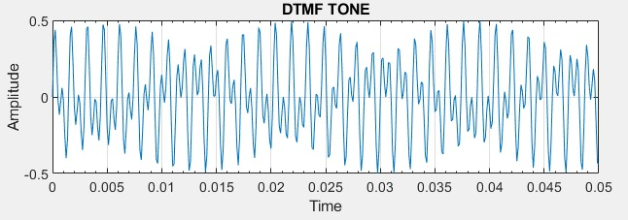
Processing techniques
Encoding
DTMF encoder is the mobile device dial pad of the user.
The 4 rows and 4 columns of the keypad form a matrix consisting of low frequency along the rows and high frequency along with the columns.
When a key is pressed, a specific frequency is generated which is the result of the combination of the two frequencies: one from low-band and one from high-band.

Slide 6
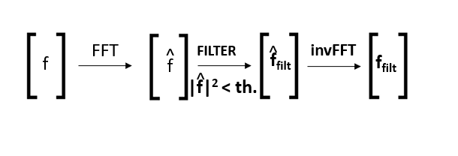
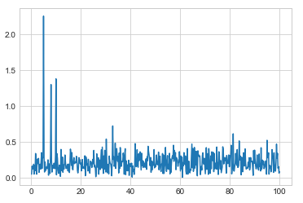
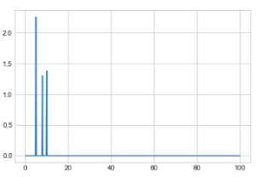
Processing techniques
DECODER
Denoising:
using FFT(Fast Fourier Transform).
converting signal to a FFT coeffect vector.
threshold PSD value is set, freq. lower than threshold
are set zero using vector.
the inverse FFT of this gives noise removed signal.

Slide 7
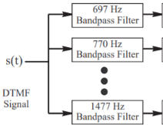
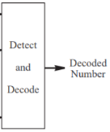
Processing techniques
DECODER
Bandpass filter:
8 BPF with central freq. as DTMF freq.
The signal is pass through all 8 filters.
The freq. corresponding to the 2 filters having highest output is the desired freq. signal.
The number corresponding to the 2 freq. is converted to binary and is send to Arduino.

Slide 8
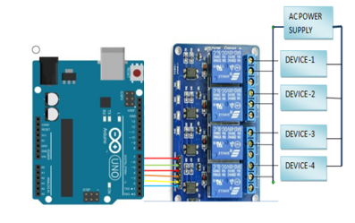
Processing techniques
DECODER
ARDUINO
Out of the 14 digital input/output pins, 4 takes input from decoder and 4 gives output to relay module.
using Arduino programming language input and output relation is provided.
e.g. if I/P is 0011 we can set O/P as high,low,high,low for relay to function.
Relay Module
The relay module is used to provides the functionality to turn on/off the current.
Each relay in module is connected to the appliance.
These channels reviews high/low voltage from the Arduino.
For instance, if a high, low, high, low sequence is received from Arduino, appliance corresponding to the connection 1st and the 3rd relay to turn on.

Slide 9
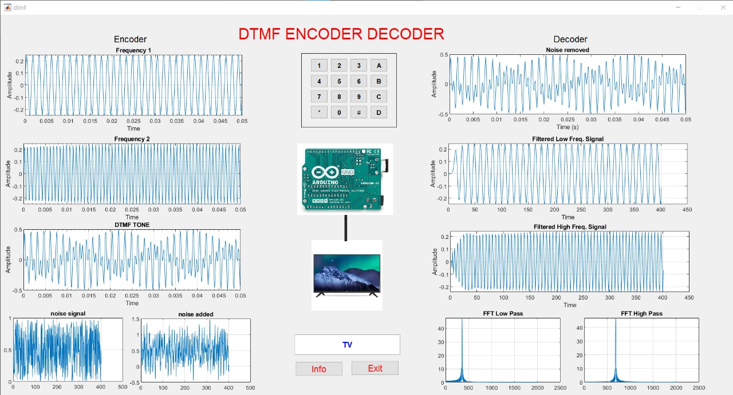
Results layout
DTMF tone wave of numeric 2
DTMF tone spectrum of numeric 2

Slide 10
CONCLUSION
It has been conceivable to control all home appliances automatically with the help of mobile phones.
Nowadays Mobile phones are an essential part of life, hence anybody can operate our system without any prior training.
With the help of the project, we can operate home appliances from anywhere in the world.
It reduces the wastage of the electricity when we forgot to switch off the lights & fans and gone outside.

Slide 11
Thank You

